Slide 1
Lactose Intolerance Lab
The Schmoos
Jillian Solomon, Madison Abdo, Natasha De Souza, Monet Munguia, Maya Jurayj, & Nadia Slawick

Slide 2
Background Information (⅓)
Some individuals produce insufficient quantities of Lactase, an enzyme that breaks the bonds in lactose (milk sugar). Lactose is a disaccharide sugar, i.e., it is composed of two simple sugars - glucose and galactose. The condition in on which lactase is not produced so lactose is not able to be broken down into two simpler sugars is referred to as lactose intolerance. With this condition the lactose from milk and various other milk products remains undigested and causes an increase in the osmotic pressure in in the intestinal contents. Consequently, water is “drawn” from the tissues into the intestine. At the same time, intestinal bacteria may act upon the undigested lactose and produce organic acids and gases. As a result, the person may feel bloated and suffer from internal cramps, diarrhea, and gas.

Slide 3
Background Information (⅔)
Researchers at Lactaid, Inc. discovered a way to mass-produce the lactase enzyme. The mass-produced lactase is formulated into a tablet and sold as Lactaid. The enzyme units in Lactaid are eaten by the lactose-intolerant person before or simultaneous to ingesting lactose. The Lactaid breaks down the lactose and and then the person’s system can utilize the resulting glucose and galactose.

Slide 4
Background Information (3/3)
An external way to test the effectiveness of Lactaid is to find an organism that will only digest simple sugars and not digest lactose. In this experiment, yeast is used as a test organism. Yeast does not produce lactase and therefore, cannot digest lactose.
Yeast can, however, digest glucose very efficiently. When it digests glucose, the yeast breaks down the glucose and produces CO2 gas a waste product. This production of gas can be easily monitored. The absence or presence of CO2 gas will be used as evidence of digestion by the yeast.

Slide 5
Experimental Procedure (Step 1)
Divide the water and the yeast into four equal portions. Each flask will contain 3 grams of yeast and 125 mL of water.

Slide 6
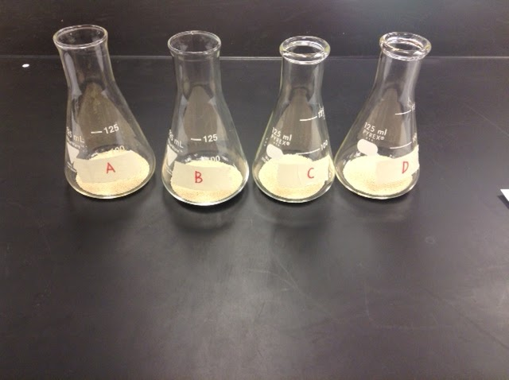
Step 2
2)Fill each flask with 3g of the yeast.

Slide 7
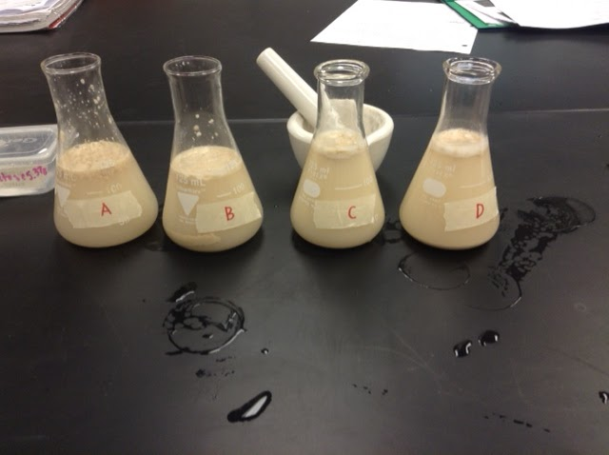
Step 3
3.) Add 125mL of water to each flask.

Slide 8
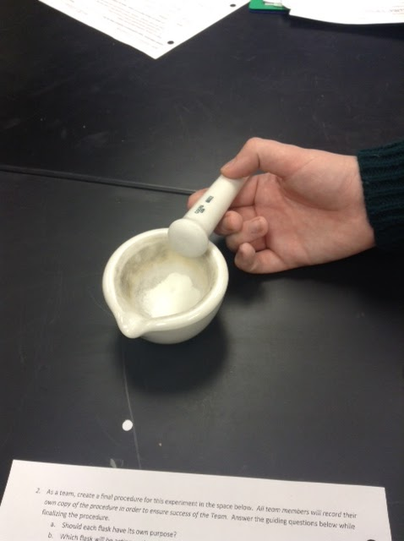
Step 4
4) Use the mortar and pestle to grind half of a lactose tablet.

Slide 9
Step 5
5) Label flasks A, B, C, and D

Slide 10
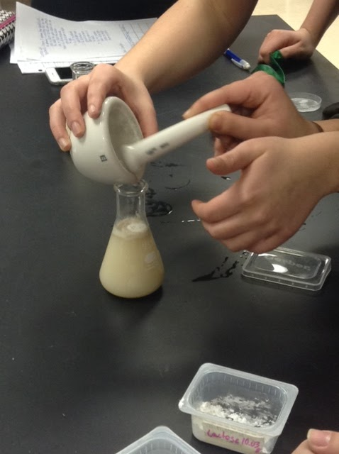
Step 6
6) Pour 125 mL of water in each flask and add in the required materials.
Flask A- 5 g of glucose
Flask B- 5 g of galactose
Flask C- 5 g of lactose with crushed tablet
Flask D- 5 g of lactose

Slide 11
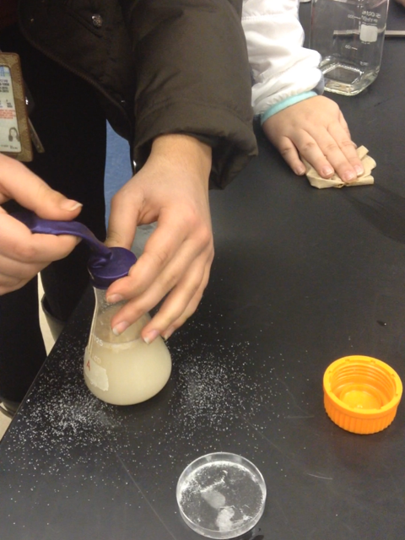
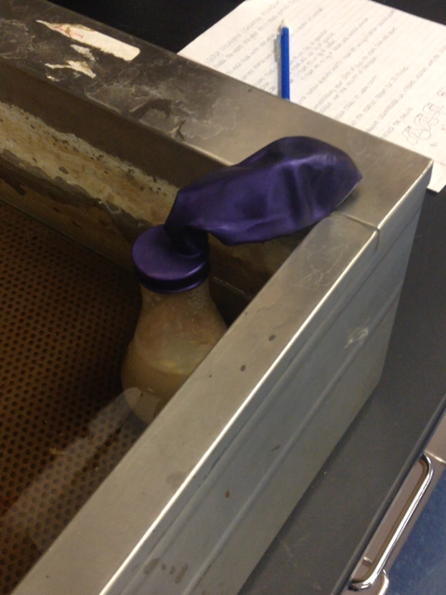
Step 7
7) Immediately put balloons on all four flasks and place in the thermometer water bath. Let sit for 30 minutes.

Slide 12
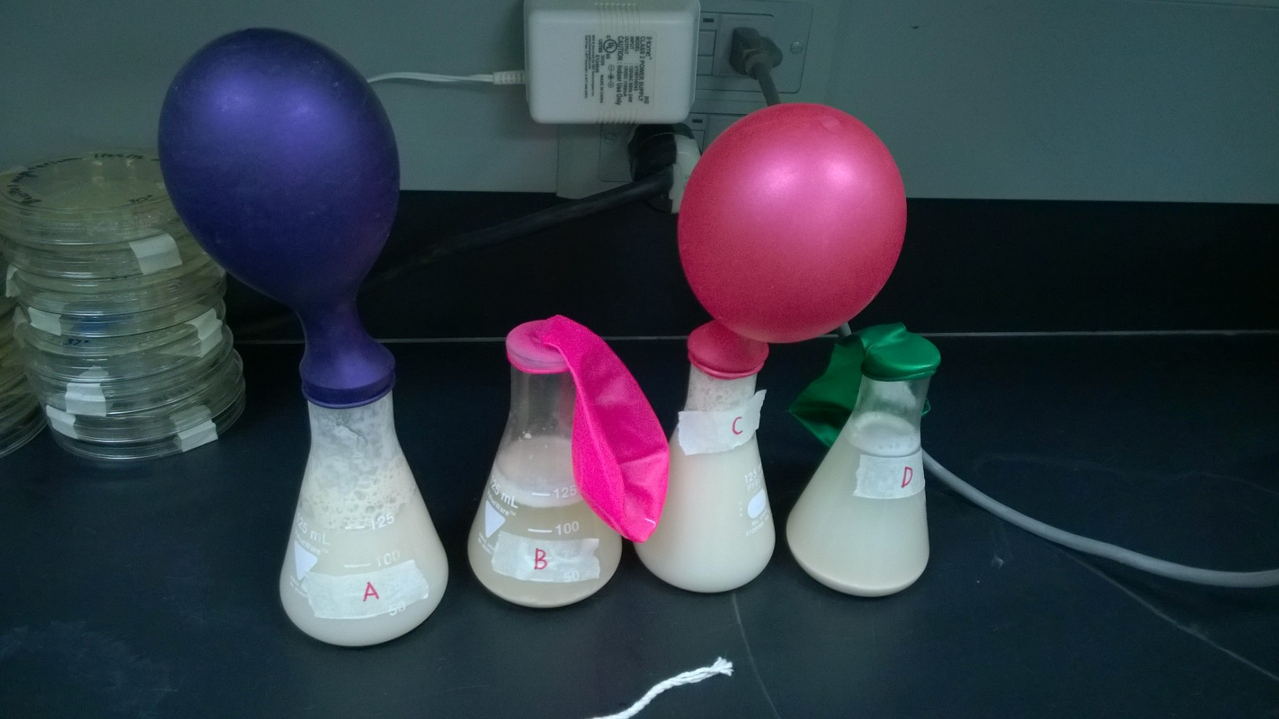
Step 8
8) Measure the amount of carbon dioxide released by measuring the circumference of the balloon with a string and feeling the pressure of the balloon.

Slide 13
Hypotheses
Flask A (Glucose): The yeast in this flask will produce the most Carbon Dioxide. As a result, the balloon will be the most inflated out of the four.
Flask B (Galactose): The yeast will produce Carbon Dioxide but not as much as Flask A and Flask C. The balloon will be somewhat flimsy.
Flask C (Lactose and Lactaid powder): The yeast will produce a substantial amount of Carbon Dioxide, but less than the flask that contains glucose. This balloon will be highly inflated as well.
Flask D (Lactose): The yeast will produce no Carbon Dioxide, resulting in a completely deflated balloon.

Slide 14
Data Collection
 | Glucose Flask A Purple balloon | Galactose Flask B Pink Balloon | Lactose & Lactaid Flask C Metallic Red Balloon | Lactose Flask D Green balloon
Circumference | 24.5 cm | 0 cm | 26 cm | 0 cm
Pressure | Firm/ pressurized | Flimsy | Firm/ pressurized | Flimsy, uninflated

Slide 15
Team Conference #2
Flask 1 (A) Flask 2 (B) Flask 3 (C) Flask (D)
5g Glucose 3g yeast 125 mL water | 5g Galactose 3g yeast 125 mL water | 5g Lactose & ½ tablet of Lactaid 3g yeast &125 mL water | 5g Lactose 3g yeast 125 mL water
CO2 produced - yeast was able to digest glucose easily | CO2 not produced - yeast did not digest galactose efficiently | CO2 produced - yeast was successful in digesting lactose with the help of the Lactaid | CO2 not produced - yeast could not digest lactose by itself
This tells us that yeast can easily digest glucose and is a key source of their energy (ATP) | This result tells us that yeast does not prefer to use galactose as a source of energy b/c it requires more effort to digest | This tells us that with Lactaid, which contains lactase, the yeast was able to break down the lactose into glucose+galactose, and then they digest the glucose producing energy&CO2 | This result tells us that without the Lactaid the yeast was not able to digest the lactose into glucose&galactose.
The experimental nature of the flask before placing in hot water bath
A
B
Results
What does this tell us about the metabolic abilities of yeast?
C

Slide 16
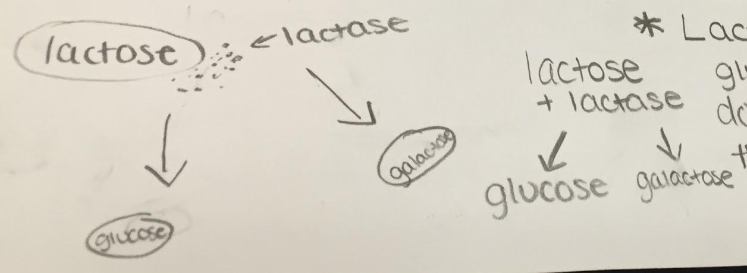
Team Conference #2 Continued
Why were the flasks incubated at 37 degrees Celsius?
The yeast in the flasks are activated and stay active when kept in temperatures from 37-41 celsius
2. Write the chemical formula for cellular respiration
C₆H₁₂O₅ 2 CH₃CH₂OH + 2 CO₂ + Energy (glucose)
3. Diagram and describe the lactose and lactase reaction
Lactose is composed of two monosaccharides glucose + galactose, and can broken down into those sugars with the help of the enzymes lactase. Once lactose is broken down the sugars can be used for energy to fuel cell/body.

Slide 17
Team Conference #2 Continued
4. Why did the enzyme react to lactose but not sucrose?
The yeast cannot break down the sugar lactose into its component parts. Although lactose is similar to sucrose, lactose will break down any lactase due to the shape of the sugar.
5. Another way to affect the enzyme is by lowering the pH of the solution. However, lactase is supposed to be able to work in the stomach. Would lowering the pH of the enzyme soultion affect the enzyme? Why or why not?
Yes, lowering the pH would affect the enzyme because they already operate at a low pH and lowering it anymore would lessen its specific activity and its rate of activity.

Slide 18
Team Conference #2 Continued
6. What type of reaction (Dehydration or hydrolysis) is occurring in the lab?
Dehydration is occurring in the lab.
7. How did the addition of lactase (crushed Lactaid tablet) affect the production of CO2 (respiration rate)? Why?
The addition of lactase increased the production of CO2 because the yeast were able to break down the lactose into digestible sugars. When those sugars are digested CO2 is produced.

Slide 19
Team Conference #2 Continued
8. According to your results, were the yeast able to metabolize lactose? Can yeast digest glucose efficiently?
Yeast was only able to metabolize lactose with lactaid. Yeast can digest glucose efficiently
9. Lactose intolerance is a condition in which people are unable to digest lactose. How does the product “lactaid” assist these people?
Lactaid provides the lactase needed to digest lactose so people that are lactose intolerant will be able to eat foods with lactose and be able to digest it

Slide 20
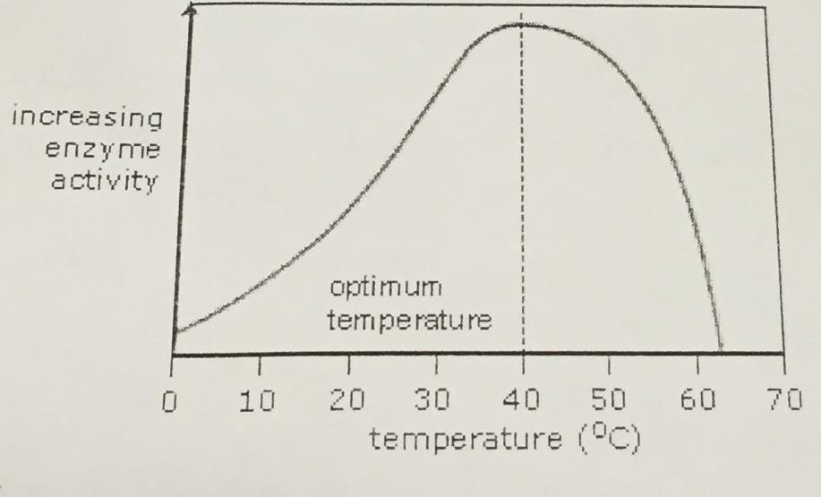
Team Conference #2 Continued
10) Interpret the graph to answer the following three questions:

Slide 21
Team Conference #2 Continued
Why is there a decrease in enzyme activity between 50 and 60 degrees Celsius?
Enzymes function properly at specific temperatures so when the temperatures are above or below the optimum, the enzymes activity depletes.
B) What physical changes (if any) are occurring to the enzyme structure?
The enzyme's active site will change with increasing temperatures causing them to not function properly.
C) What would happen to our lactose lab results of the water temperature decreased by 20 degrees Celsius?
Our results would be very different. The enzymes would not function properly and the cellular respiration would be delayed producing less carbon dioxide and there would be less energy.

Slide 22
Final Claim Evidence Reasoning Conclusion
What was the purpose of this Lactose Intolerance Laboratory? In your explanation describe how lactose is used in living organisms.
The main purpose of this Lab was to find out if yeast are lactose intolerant, and then,to examine the effect lactase has on lactose. In most organisms, lactase breaks down the bonds in lactose (an enzyme composed of glucose and galactose).
Our main source of lactose comes from dairy; when the body produces an insufficient amount of Lactase, the body is unable to digest dairy. Because lactose remains undigested, CO2 gases are produced causing bloating and other symptoms.

Slide 23
Final Claim Evidence Reasoning Conclusion Continued...
B) Using Claim, Evidence, and Reasoning format report findings and answer the original question.
Through this lab, it became evident that yeast can effectively digest glucose, and with the aid of lactaid, it can also efficiently break down lactose into the simple sugars that it needs. When the yeast digests glucose, it releases carbon dioxide along with water in order to create energy. The results of this lab showed that Flask C, lactose and lactaid, expanded to a great amount due to the yeasts release of carbon dioxide, allowing us to accept the hypothesis created for this flask. This balloon had an increase in circumference of 26 centimeters. In flask D, which contained lactose, there was no change in the circumference of the balloon. This allows us to accept our hypothesis regarding this flask. There was no lactose digested by the yeast, resulting in the absence of carbon dioxide.

Slide 24
Final Claim Evidence and Reasoning Conclusion Continued...
B continued)
Regarding flask A, containing glucose, the circumference of the balloon increased to 24.5 centimeters. Therefore, the yeast was able to digest this sugar, but not as effectively as the flask that contained lactose and lactaid. Finally, Flask B, containing galactose, had no change in circumference, just as Flask D. The results of this lab can be explained by the properties of lactase, the enzyme that is contained within the lactaid tablets. The tablet allows all organisms who cannot naturally create lactase of their own to effectively digest the lactose. Since yeast releases carbon dioxide when it digests and breaks down sugars, the amount of carbon dioxide produced was easily measured through the expansion of the balloons. Therefore, this indicated that they yeast had successfully digested the substance that was in the flask.

Slide 25
Final Claim Evidence Reasoning Cont’d.
C.) Reflect on how to improve the experiment designed by your team. How would this improve the experimental results?
The experiment could have been improved if the fact that the water bath was not working effectively had been discovered earlier. If so, the entire experiment would have been executed more efficiently, and the results could have been obtained more accurately and in a shorter amount of time. Because this fact went undetected so long, the experiment was prolonged by an hour. Additionally, the glucose was not added to the flask with enough precision. As a result, some of the glucose fell on the table, and there was less in the flask than there should have been. Because there was less glucose, there was most likely less CO2 produced as waste, which made the results inaccurate. Had the glucose been added with more care, the results might have been more accurate.

Slide 26
Final Claim Evidence Reasoning Conclusion Continued...
D) Considering the results of your experiment what could you be investigating next? What could be learned from this investigation?
Considering our results, we could investigate why yeast was used in comparison of human reactions. Since the yeast reacted to the lactaid the same way as a human would, we could investigate the similarities between the components of yeast and the components of the human digestive system.

